Slide 1
Average depth of randomly generated binary search trees

Slide 2
Outline
In this topic, we will:
Determine the average depth of a node in a randomly generated binary search tree
We will introduce a few examples

Slide 3
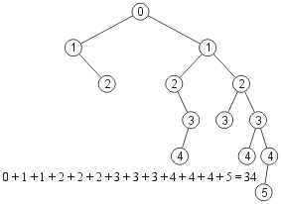
Average Depth of a Node
To proceed, we will determine what is the average height of a randomly generated binary search tree
The total internal path length is the sum of the depths of all the nodes with a tree
The average depth is the total internal path length over the number of nodes:

Slide 4
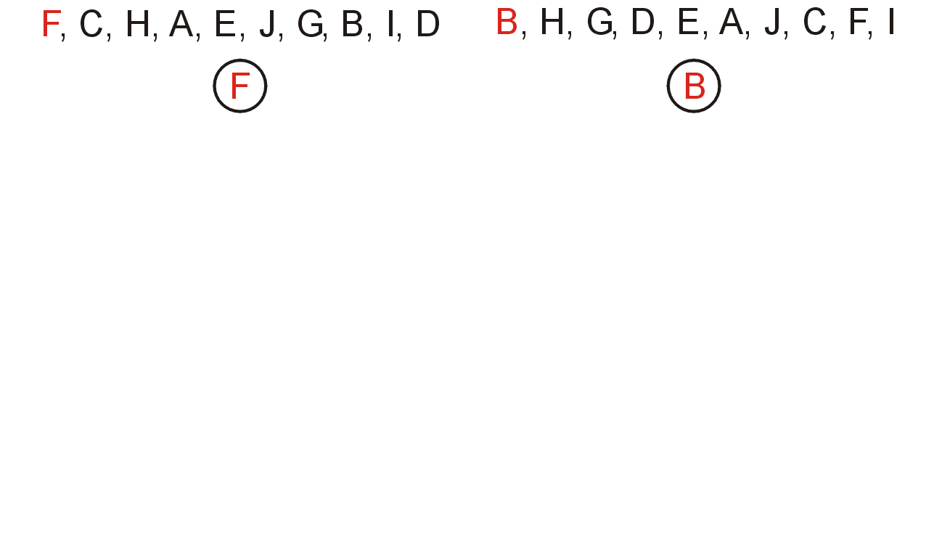
Average Depth of a Node
Consider the ten letters A-J inserted in these two orders:

Slide 5
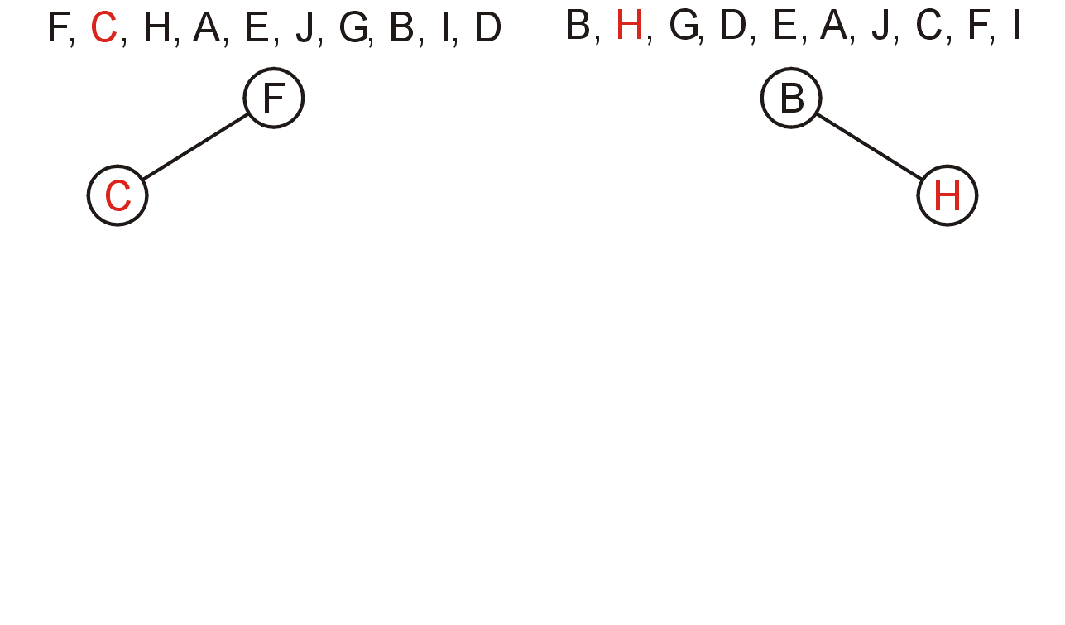
Average Depth of a Node
Next, insert C and H, respectively...

Slide 6
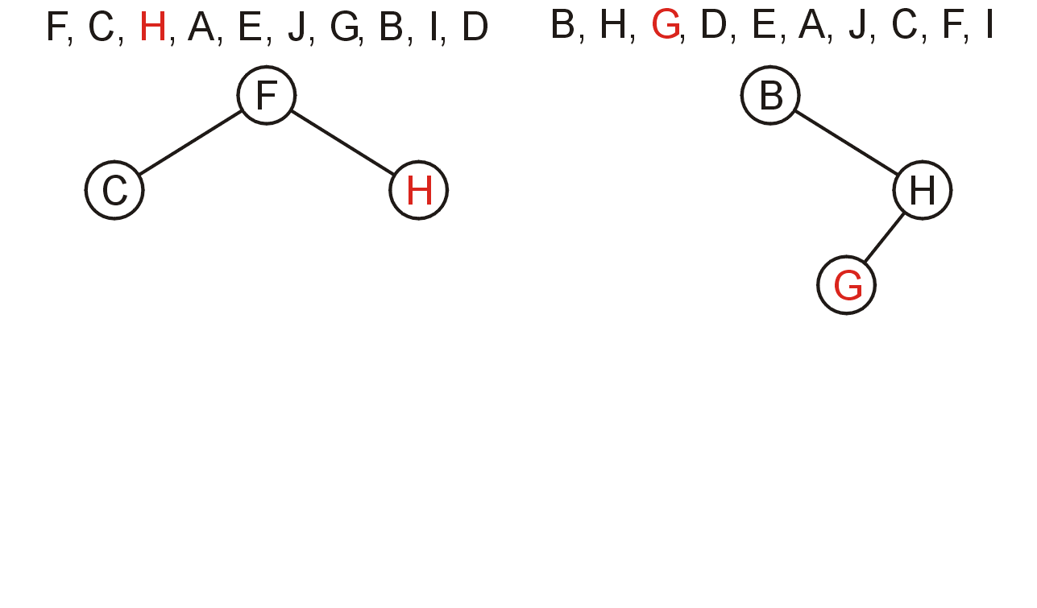
Average Depth of a Node
H and G...

Slide 7
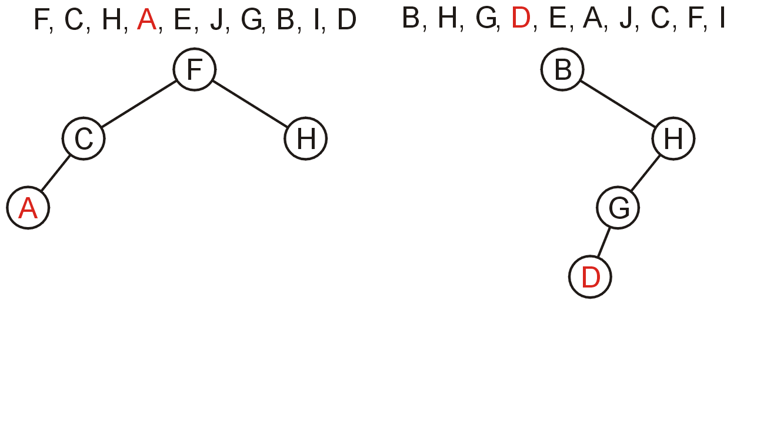
Average Depth of a Node
A and D...

Slide 8
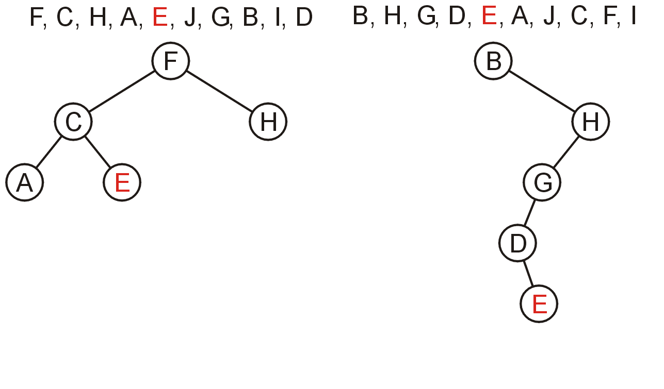
Average Depth of a Node
E and E...

Slide 9
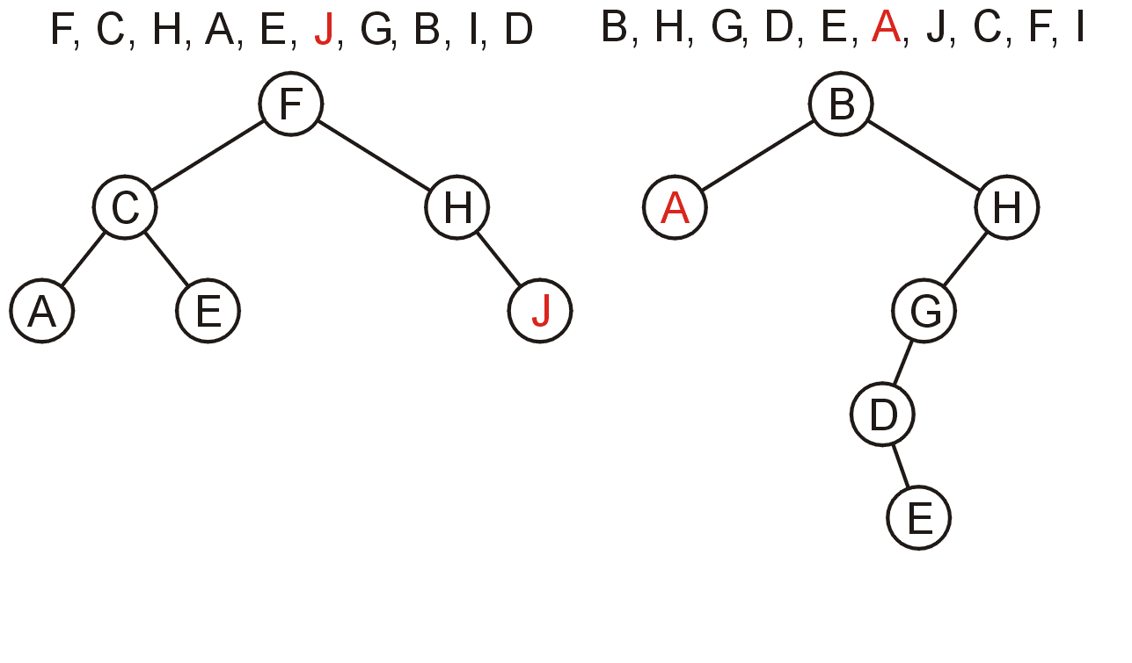
Average Depth of a Node
J and A...

Slide 10
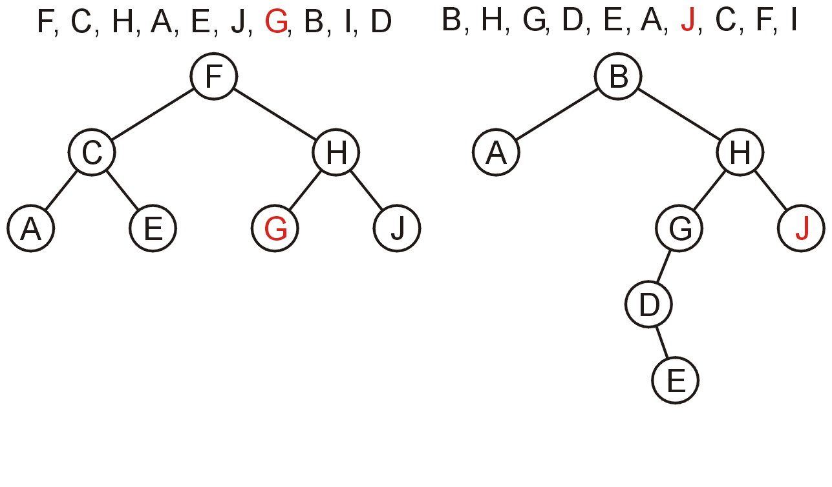
Average Depth of a Node
G and J...

Slide 11
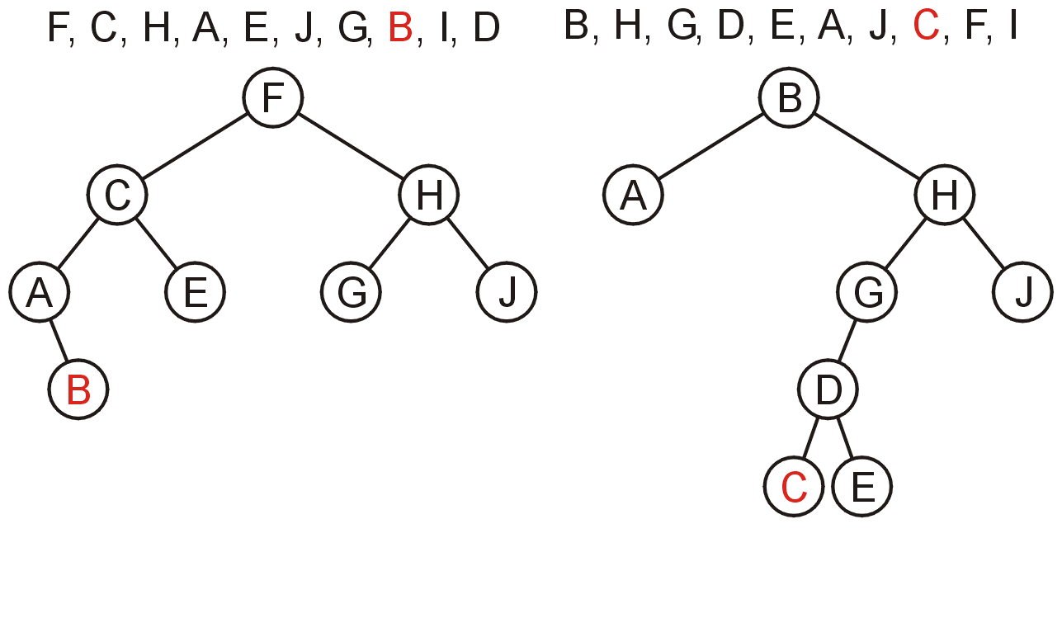
Average Depth of a Node
B and C...

Slide 12
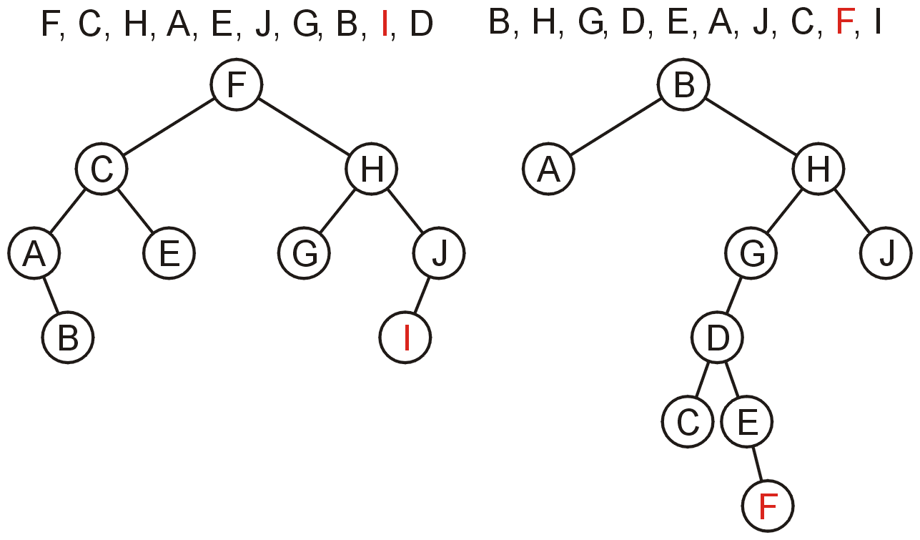
Average Depth of a Node
I and F...

Slide 13
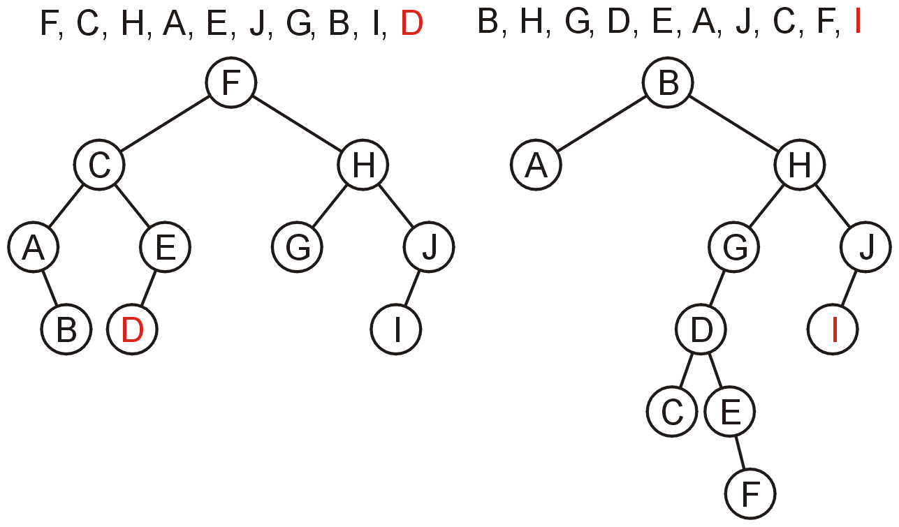
Average Depth of a Node
and finally D and I

Slide 14
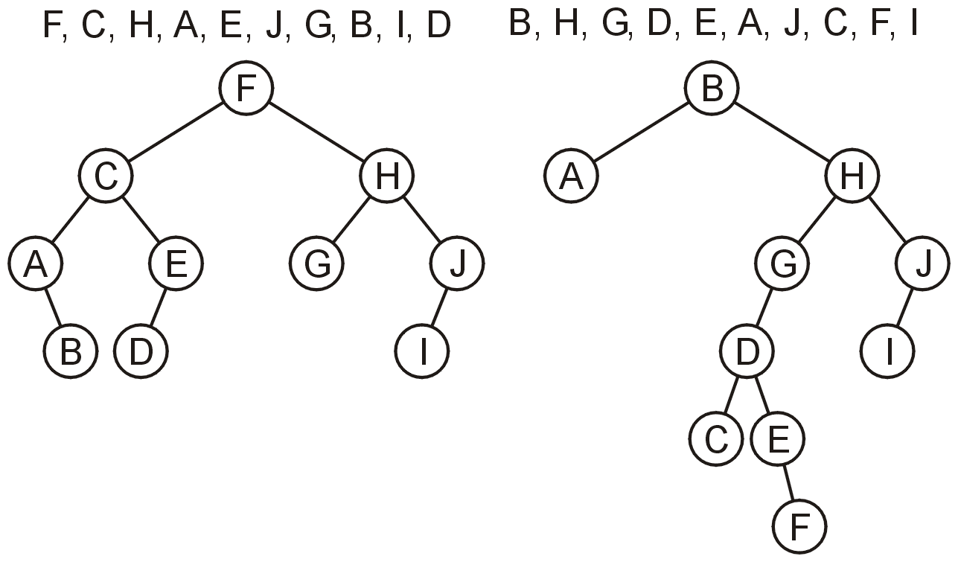
Average Depth of a Node
The total internal path lengths
19 25

Slide 15
Average Depth of a Node
The average depths
1.9 2.5

Slide 16
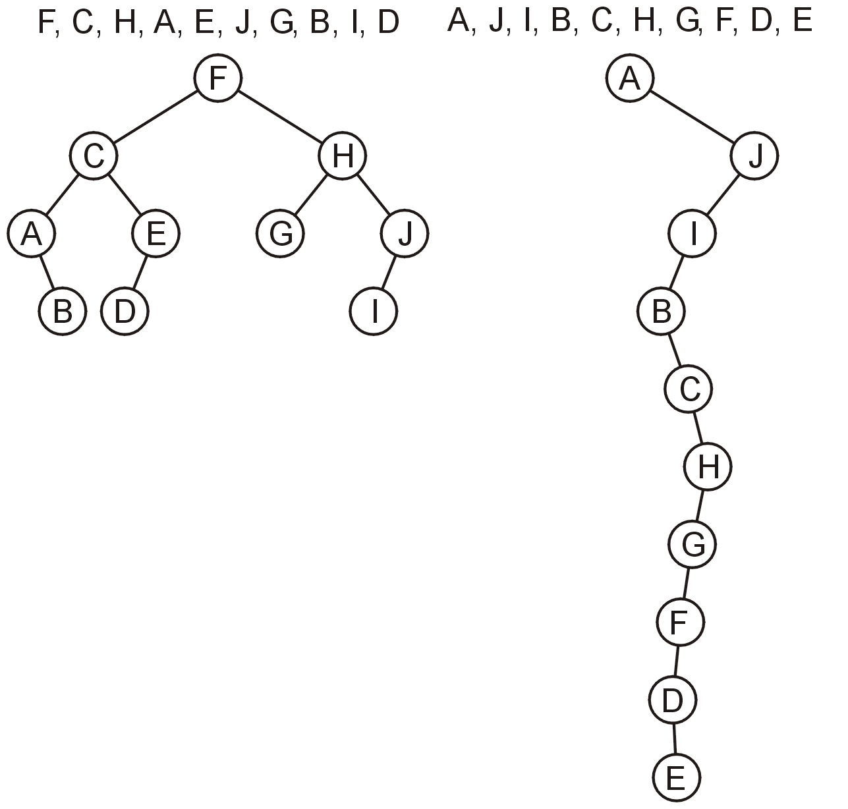
Average Depth of a Node
Best and worst average depths:
1.9 4.5

Slide 17
Average Depth of a Node
Now for the more general question:
What is the average depth of a node in a binary search tree?
We will calculate the average total internal path length in a binary search tree
we will represent this by I(n)
The average depth will be I(n)/n

Slide 18
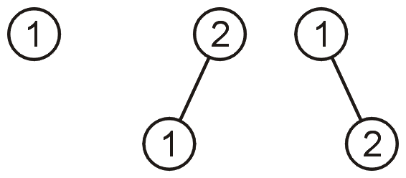
Average Depth of a Node
To begin, I(1) = 0 and I(2) = 1
Therefore the average depths for trees with 1 and 2 nodes are 0 and 0.5, respectively

Slide 19
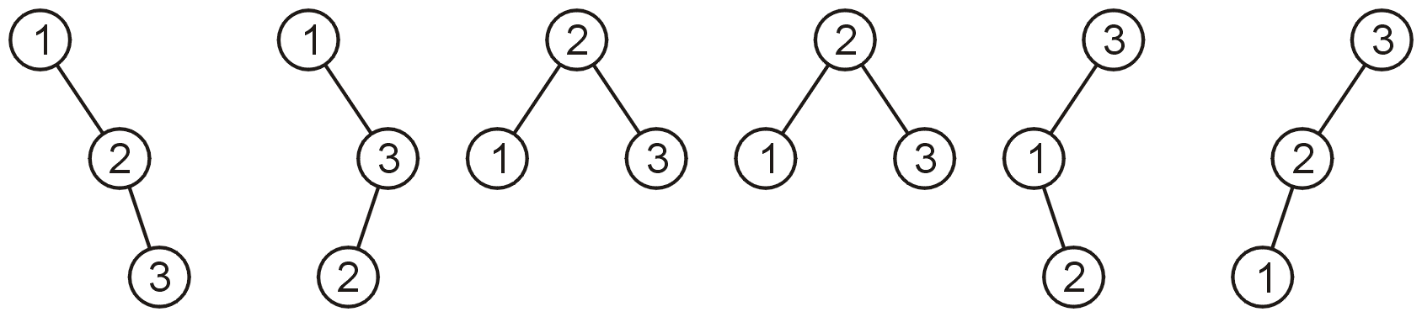
Average Depth of a Node
What is I(3)?
The three nodes values 1, 2, 3 could be added into a binary search tree in one of 3! different ways:
1,2,3 1,3,2 2,1,3 2,3,1 3,1,2 3,2,1

Slide 20
Average Depth of a Node
Counting the total internal path lengths:
3 + 3 + 2 + 2 + 3 + 3 = 16
The average total internal path length is
The average depth is I(3)/3 ≈ 0.889

Slide 21
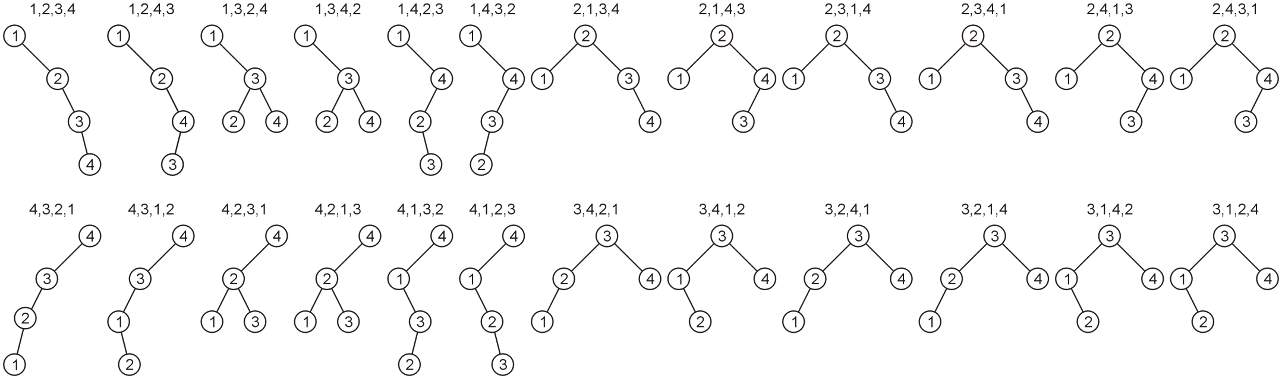
Average Depth of a Node
Finally, consider all binary search trees with four nodes:
Thus and I(4)/4 ≈ 1.21

Slide 22
Average Depth of a Node
Notice that half the trees are optimal:

Slide 23
Average Depth of a Node
We also have a symmetry that we can exploit

Slide 24
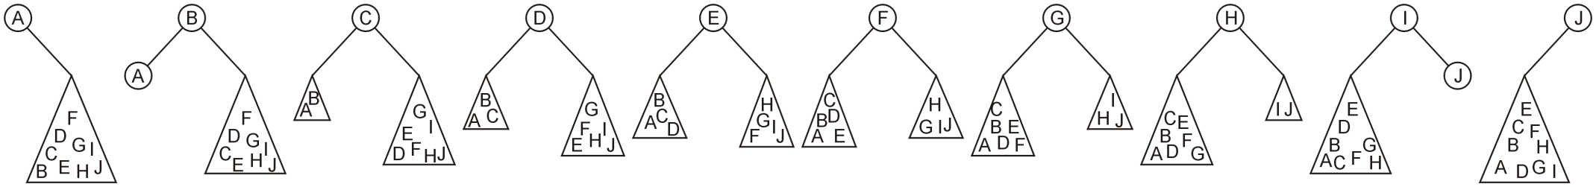
Average Depth of a Node
We, however, need a more general formula
Suppose we are randomly generating trees from the ten letters
A, B, ..., J
Each could appear with equal likelihood (1/10) as the root

Slide 25
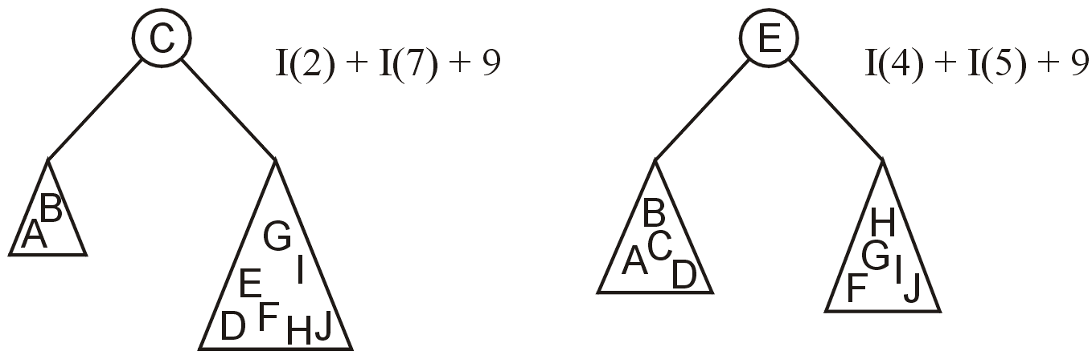
Average Depth of a Node
Lets look at two of these cases:
The average total path length is:
The sum of the two average total path lengths of the two sub trees
Plus one for each node, as each path length to each of the 9 nodes is increased by 1

Slide 26
Average Depth of a Node
Consequently, we have the following formula:
Multiplying both sides by n yields

Slide 27
Average Depth of a Node
To get rid of the sum, write the equation both for I(n) and I(n – 1) and subtract
Substitute n with n – 1

Slide 28
Average Depth of a Node
This gives us a recurrence relation which we may solve in Maple:
> rsolve( { n*In(n) - (n - 1)*In(n - 1) = 2*n - 2 + 2*In(n - 1),
In(1) = 0}, In(n) );
> asympt( %, n );

Slide 29
Average Depth of a Node
This gives us the approximation
I(n) ≈ 2 (ln(n) + γ – 2)n
and thus the average depth of a node is

Slide 30
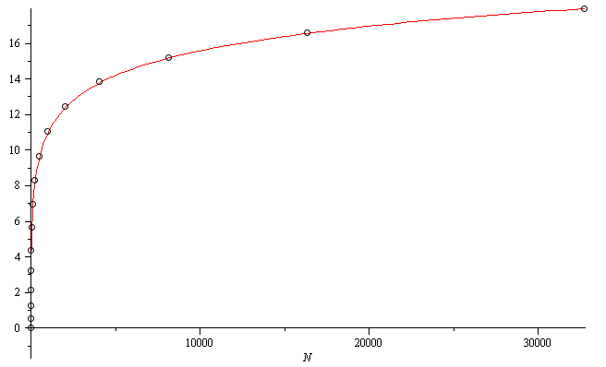
Average Depth of a Node
The course web site has a Random_tree class that can be used to generate such search trees
These points are the averages of 1000 pseudo-randomly generated trees with heights n = 2^{N} nodes for N = 0, …, 15
n

Slide 31
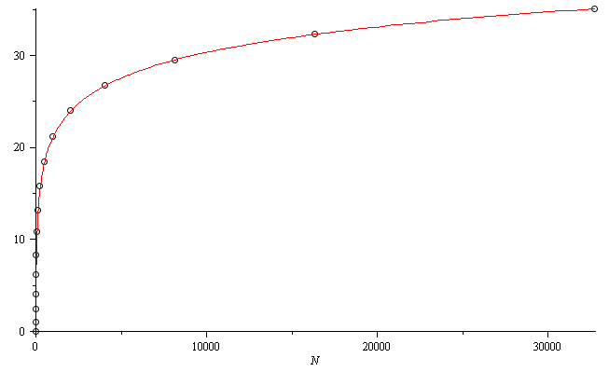
Average Height of a Node
Incidentally, the average height of 1000 pseudo-randomly generated trees also grows logarithmically
Approximately twice the average depth
Recall that the average depth of a perfect binary tree is h – 1
n

Slide 32
Average Depth of a Node
The consequence of this is reassuring:
The average depth of a node in a randomly generated tree has depth Θ(ln(n)) and the average height also appears to be Θ(ln(n))
Unfortunately, this is only the average: the worst case is still Θ(n)

Slide 33
Summary
This topic covered the average depth of a randomly generated tree
Taking n linearly ordered objects and placing them into a tree will produce a tree with an average depth of Θ(ln(n))
The average height also appears to grow logarithmically
There may be nodes that are at deeper average depths, but there are an insufficient number of these (again, on average) to affect the average run times

Slide 34
Usage Notes
These slides are made publicly available on the web for anyone to use
If you choose to use them, or a part thereof, for a course at another institution, I ask only three things:
that you inform me that you are using the slides,
that you acknowledge my work, and
that you alert me of any mistakes which I made or changes which you make, and allow me the option of incorporating such changes (with an acknowledgment) in my set of slides
Sincerely,
Douglas Wilhelm Harder, MMath
dwharder@alumni.uwaterloo.ca

